Slide 2
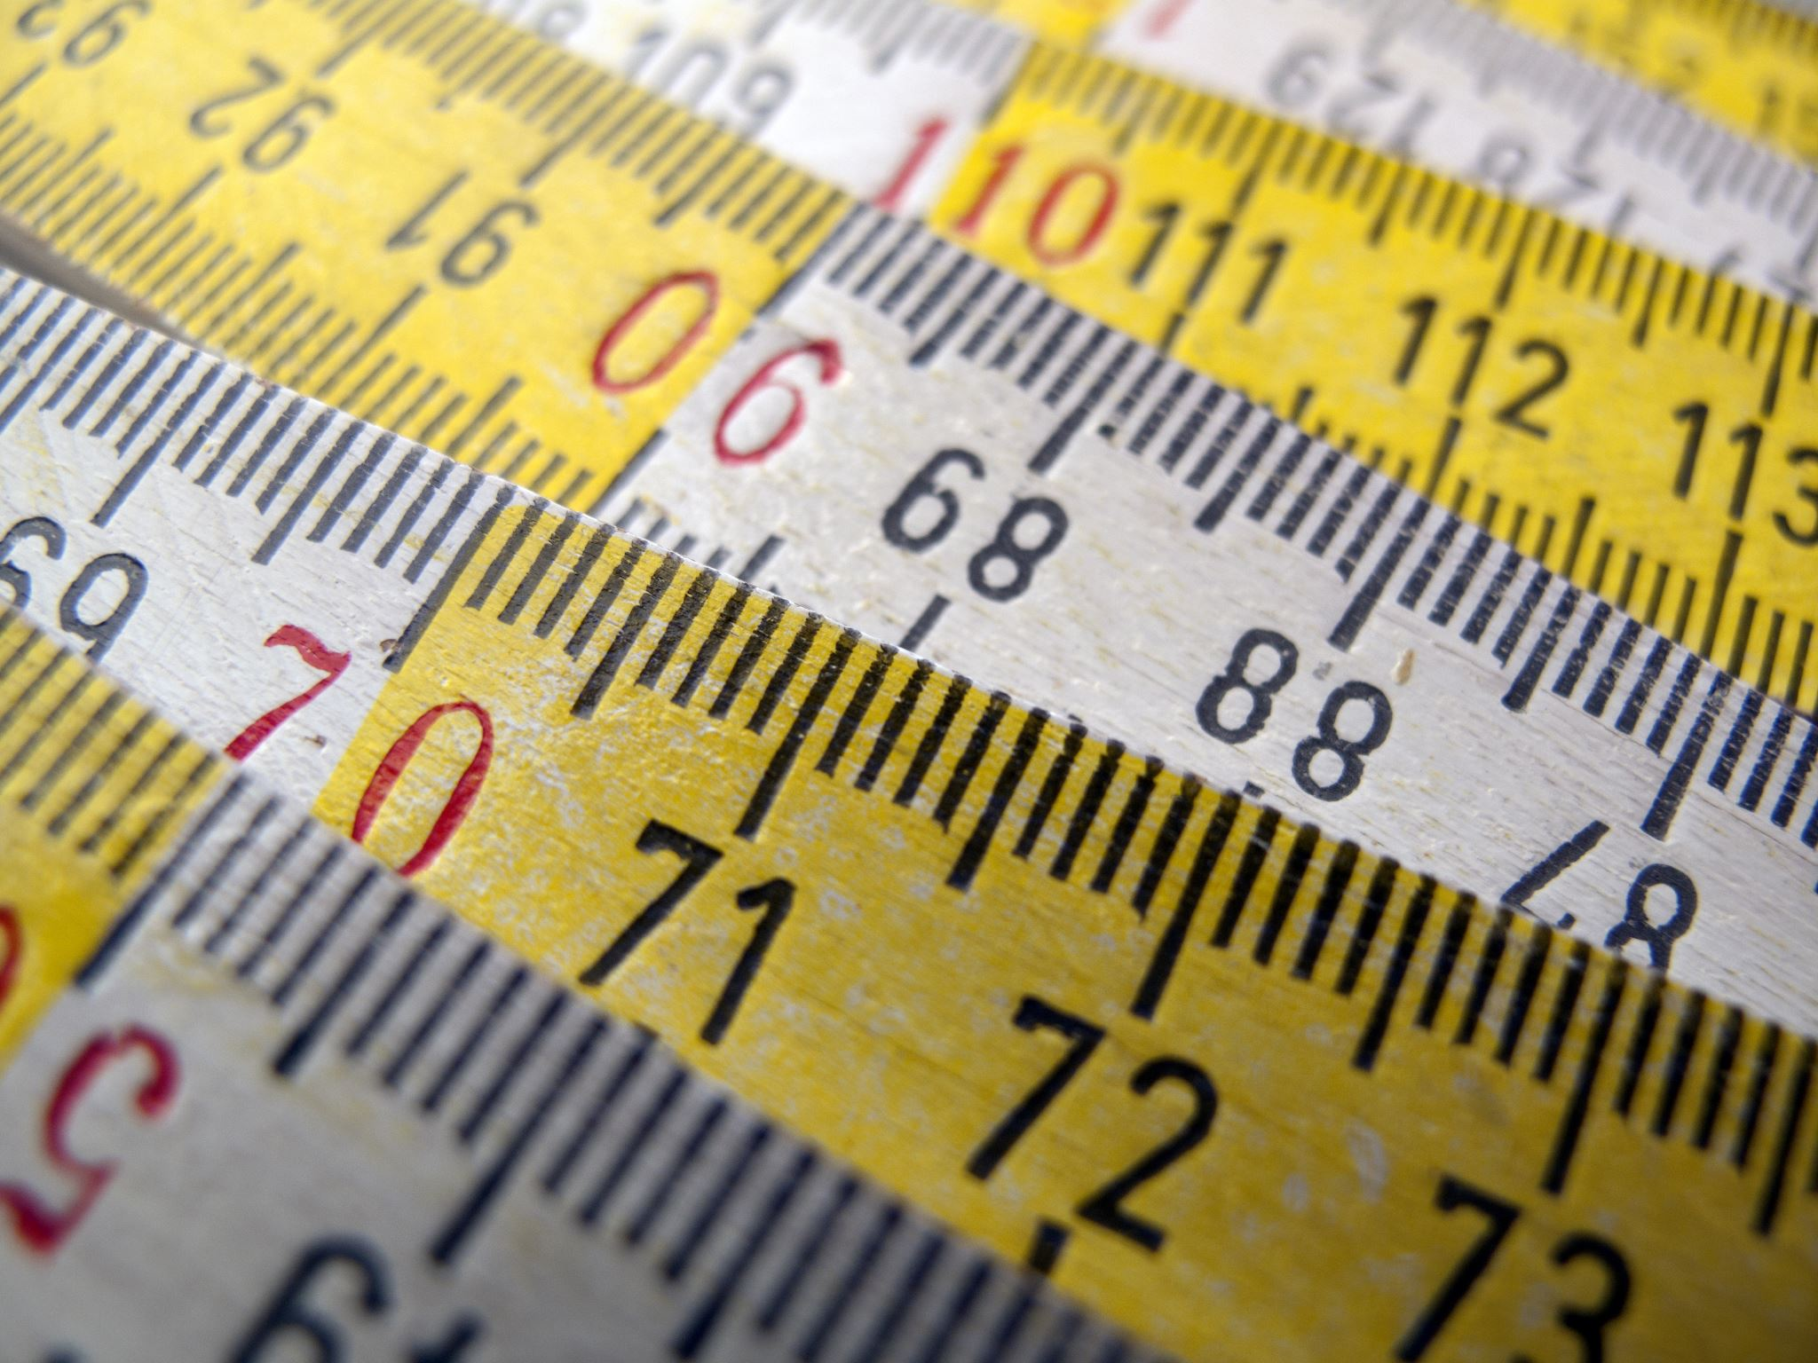
Determining Units

Slide 3
dRESP
dRESPmsr
DO temp correction
mg
28.06mL
dRESP
animal
L
1
oxySol function wql package
Actual Do mg/L
Vial Volume

Slide 4
dRESP
dRESPmsr
DO temp correction
mg
28.06mL
dRESPmsr $ oxygen
dRESP
animal
L
1
oxySol function wql package
Actual Do mg/L
Vial Volume

Slide 5
dRESP
dRESPmsr
DO temp correction
mg
.02806L
dRESPmsr $ oxygen
dRESP
animal
L
1
mg
oxySol function wql package
Actual Do mg/L
Vial Volume

Slide 6
dRESP
dRESPmsr
DO temp correction
mg
.02806L
dRESPmsr $ oxygen
dRESPmsr $ oxygen
1000
dRESP
animal
L
1
mg
µg
oxySol function wql package
Actual Do mg/L
Vial Volume

Slide 7
dRESP
dRESPmsr
DO temp correction
mg
.02806L
dRESPmsr $ oxygen
dRESPmsr $ oxygen
1000
dRESP
animal
L
1
mg
µg
oxySol function wql package
Actual Do mg/L
Vial Volume

Slide 8
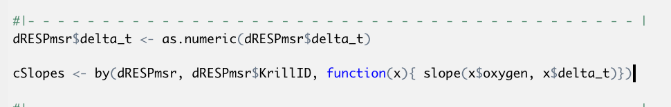
dRESP
dRESPmsr
DO temp correction
mg
.02806L
dRESPmsr $ oxygen
dRESPmsr $ oxygen
µg
cSlopes
(correction via) Blank Mean values (per trial)
Corrected Slope Values
Corrected Slope Values
Final slope values
1000
µg/min
µg/min
dRESP
animal
L
1
.00 minutes
Animal Wet Weight
mg
µg
µg/min
mg
1000
Animal Wet Weight
µg oxygen/min
µg
Slope function
µg Krill Tissue
oxySol function wql package
Actual Do mg/L
Vial Volume
dSlopes$WetWeightSlope <- dSlopes$CorrSlope/dSlopes$WetWeight

Slide 9
dRESP
dRESPmsr
DO temp correction
mg
.02806L
dRESPmsr $ oxygen
dRESPmsr $ oxygen
µg
cSlopes
(correction via) Blank Mean values (per trial)
Corrected Slope Values
Corrected Slope Values
Final slope values
1000
µg/min
µg/min
dRESP
animal
L
1
.00 minutes
Animal Wet Weight
mg
µg
µg/min
mg
1000
Animal Wet Weight
µg oxygen/min
µg
Slope function
µg Krill Tissue
oxySol function wql package
Actual Do mg/L
Vial Volume
dSlopes$WetWeightSlope <- dSlopes$CorrSlope/dSlopes$WetWeight

Slide 10
dRESPmsr $ oxygen
µg
cSlopes
(correction via) Blank Mean values (per trial)
Corrected Slope Values
Corrected Slope Values
Final slope values
µg/min
µg/min
.00 minutes
Animal Wet Weight
Animal Wet Weight
µg
µg/min
mg
1000
µg oxygen/min
µg
Slope function
µg Krill Tissue

Slide 11
dRESPmsr $ oxygen
µg
cSlopes
(correction via) Blank Mean values (per trial)
Corrected Slope Values
Corrected Slope Values
Final slope values
µg/min
µg/min
.00 minutes
Animal Wet Weight
Animal Wet Weight
µg
µg/min
mg
1000
µg oxygen/min
µg
Slope function
µg Krill Tissue

Slide 12
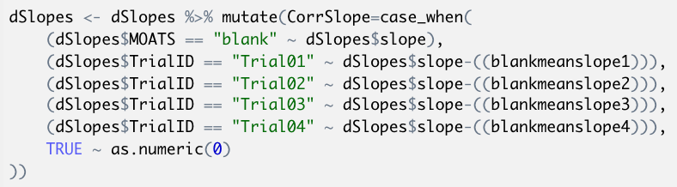
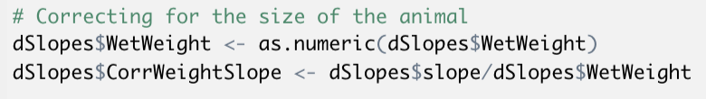
cSlopes
(correction via) Blank Mean values (per trial)
Corrected Slope Values
Corrected Slope Values
Final slope values
µg/min
µg/min
Animal Wet Weight
Animal Wet Weight
µg oxygen/min
µg/min
mg
1000
g
g Krill Tissue

Slide 13
dRESP
dRESPmsr
dRESP
animal

Slide 14
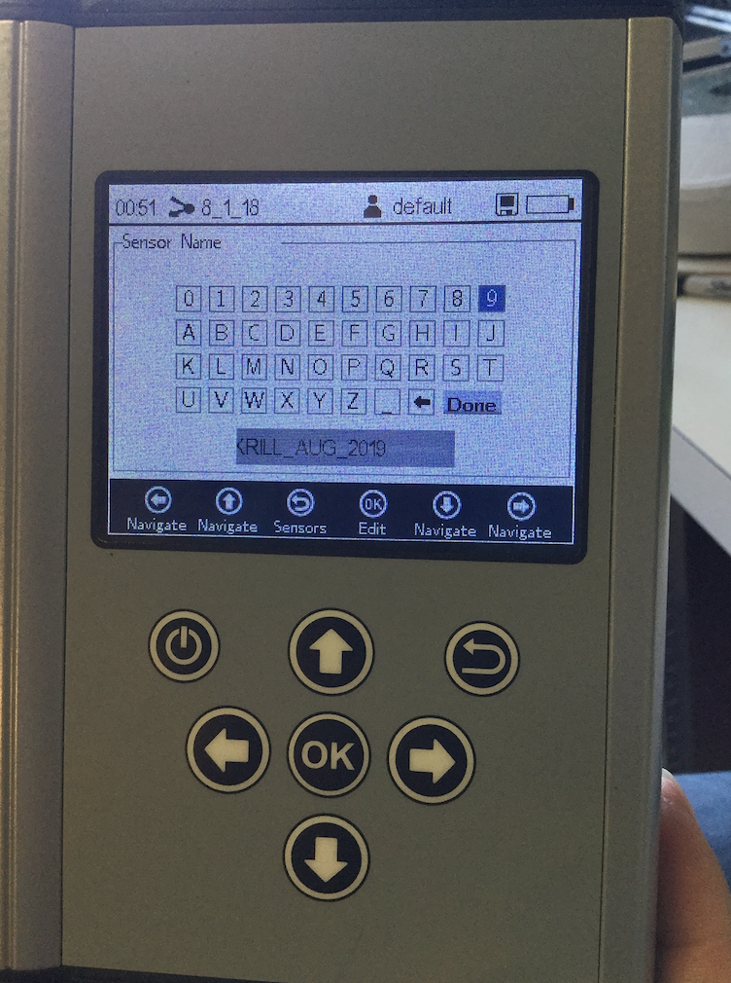
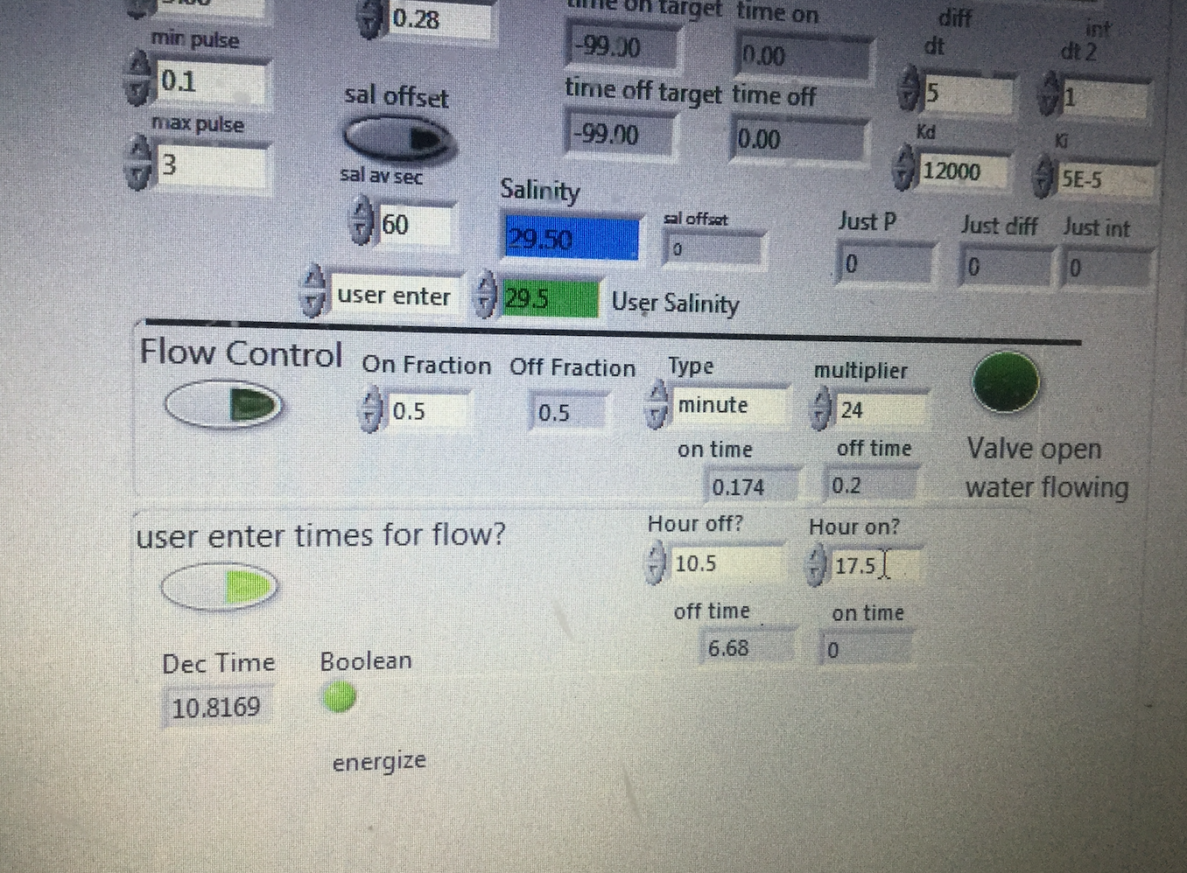

Slide 15
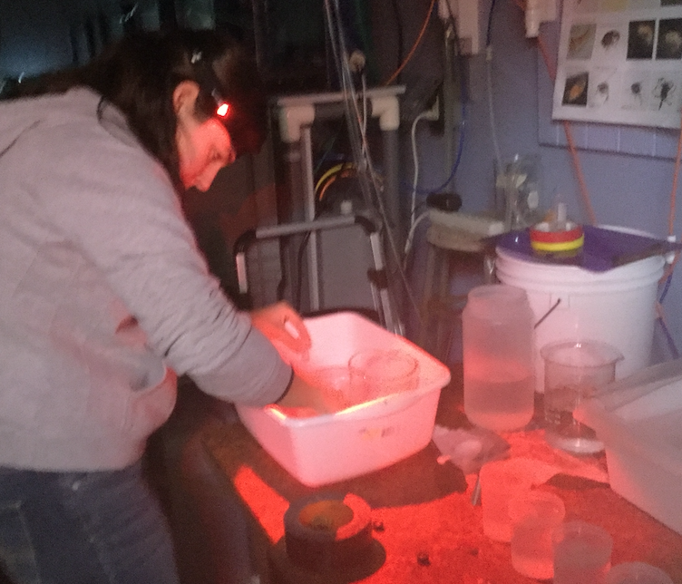
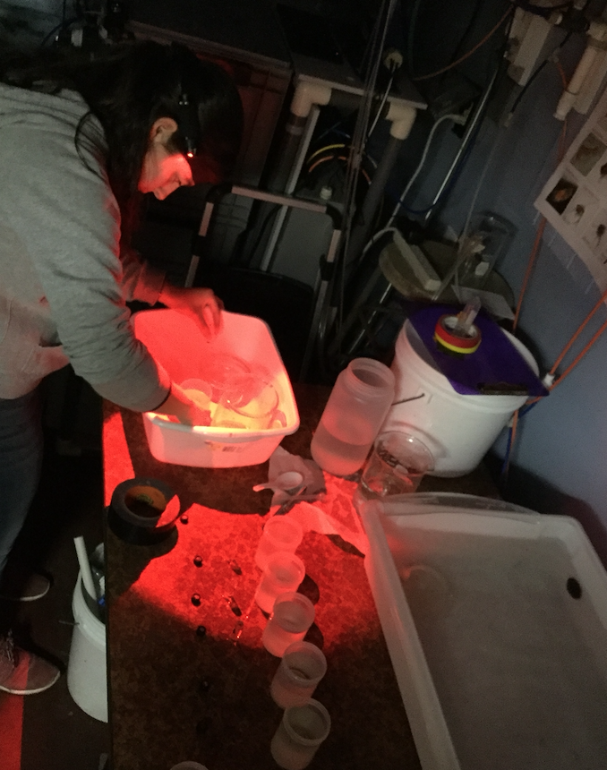
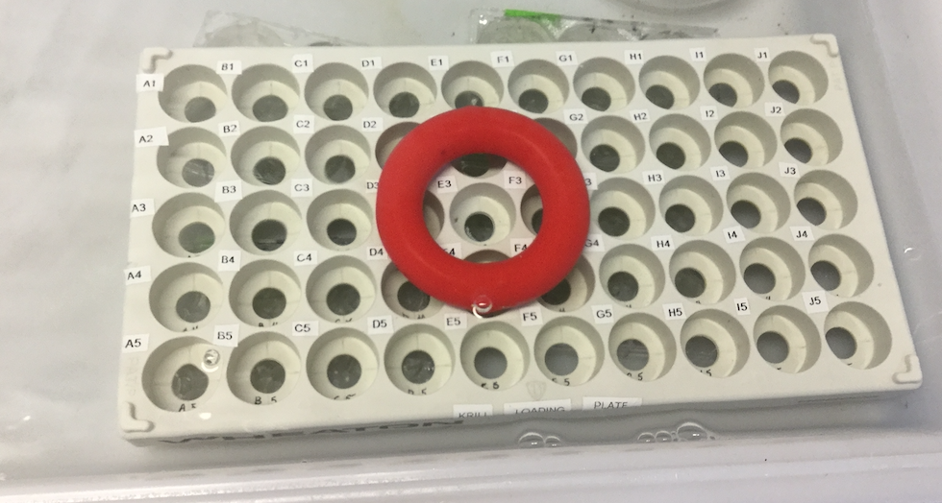
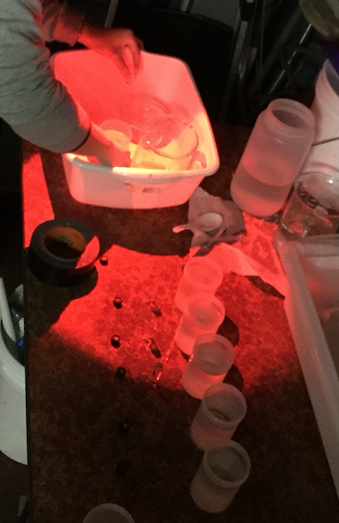
MOATs 12 Water filling waterbath

Slide 16
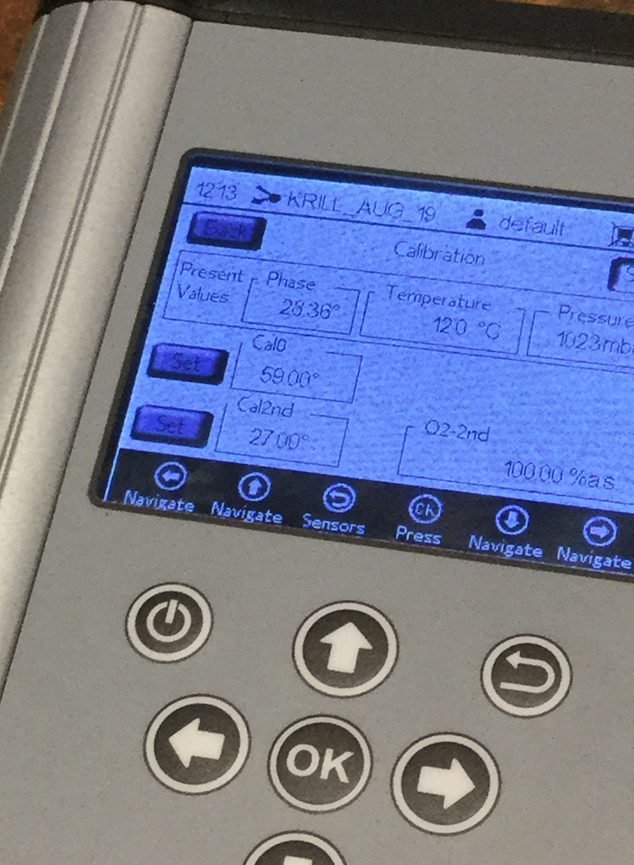
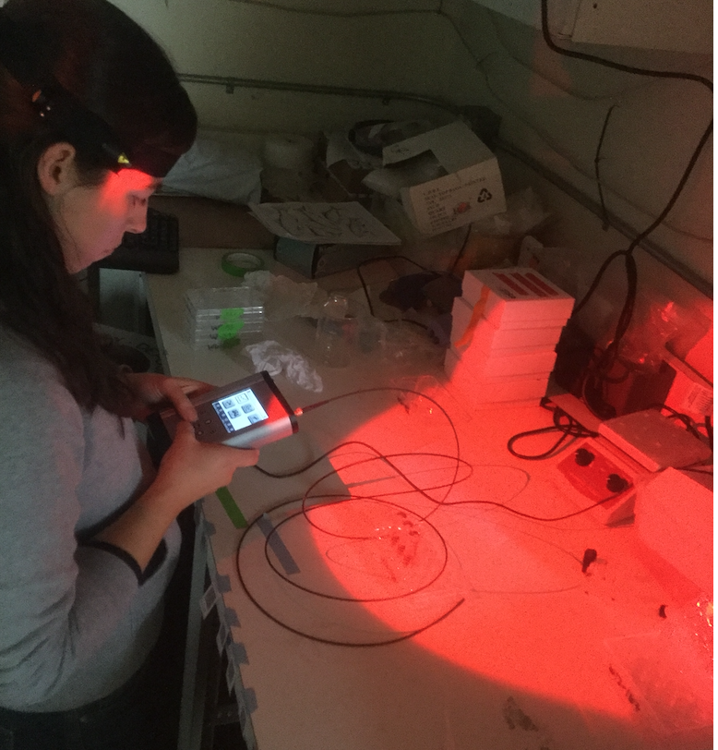
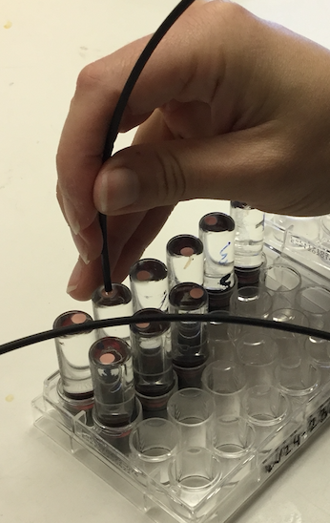
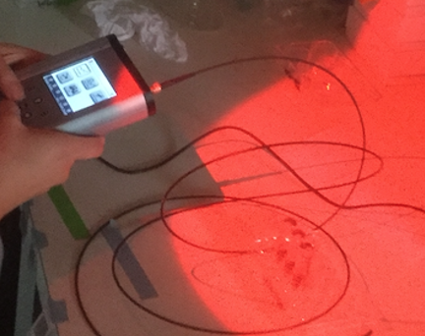

Slide 17
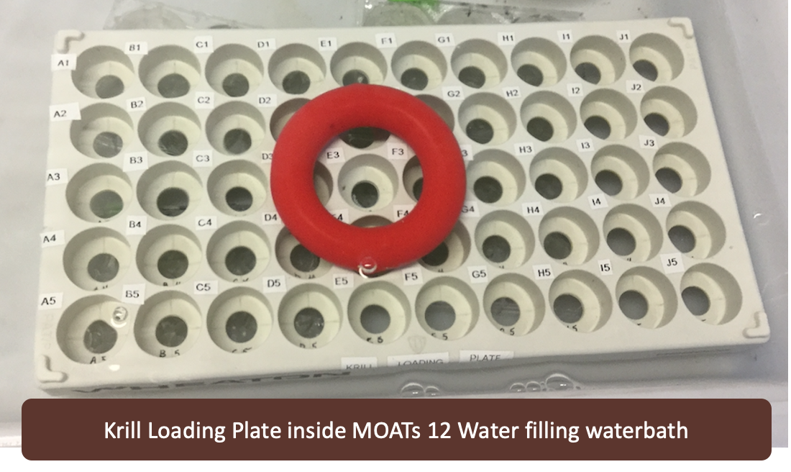
Catch Basin with MOATs 12 Water
Krill Loading Plate inside MOATs 12 Water filled Waterbath
Source MOATs 12 Water
MOATs 12 pre-filled 250mL bottles
MOATs 12 Water filling waterbath
MOATs 12 Water pre-filled in 28mL
Krill Loading Plate inside MOATs 12 Water filling waterbath

Slide 18
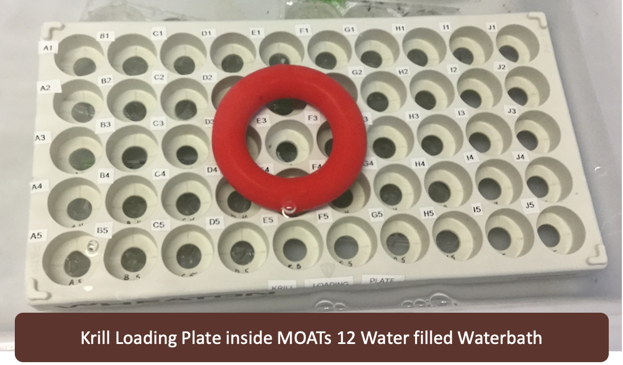
Krill Loading Plate inside MOATs 12 Water filled Waterbath

Slide 19
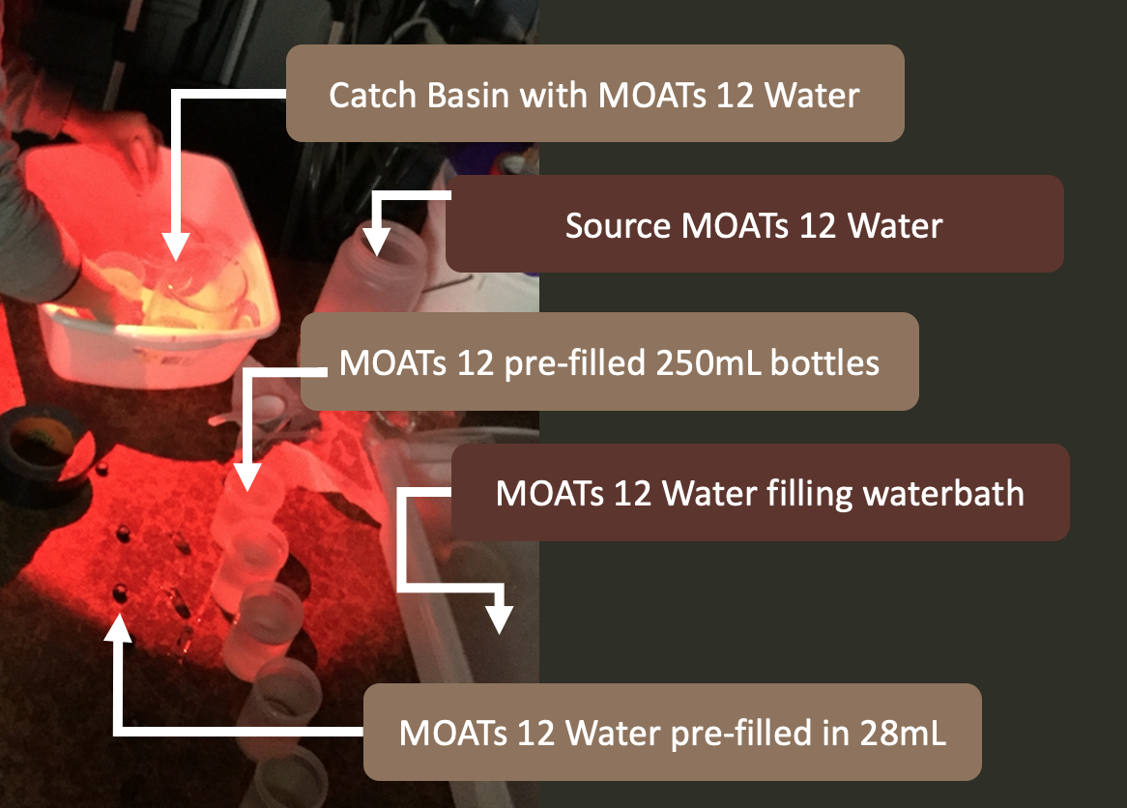

Slide 20
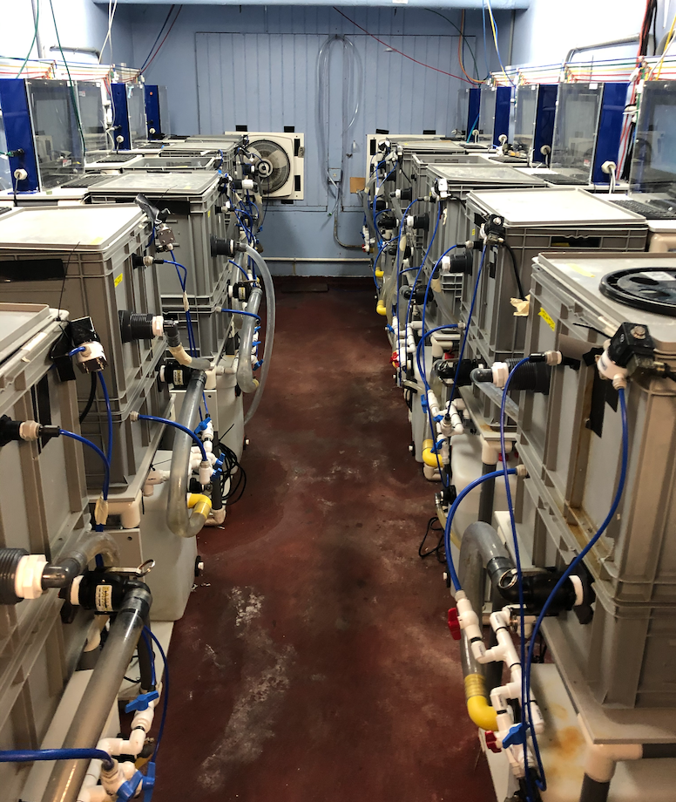

Slide 21
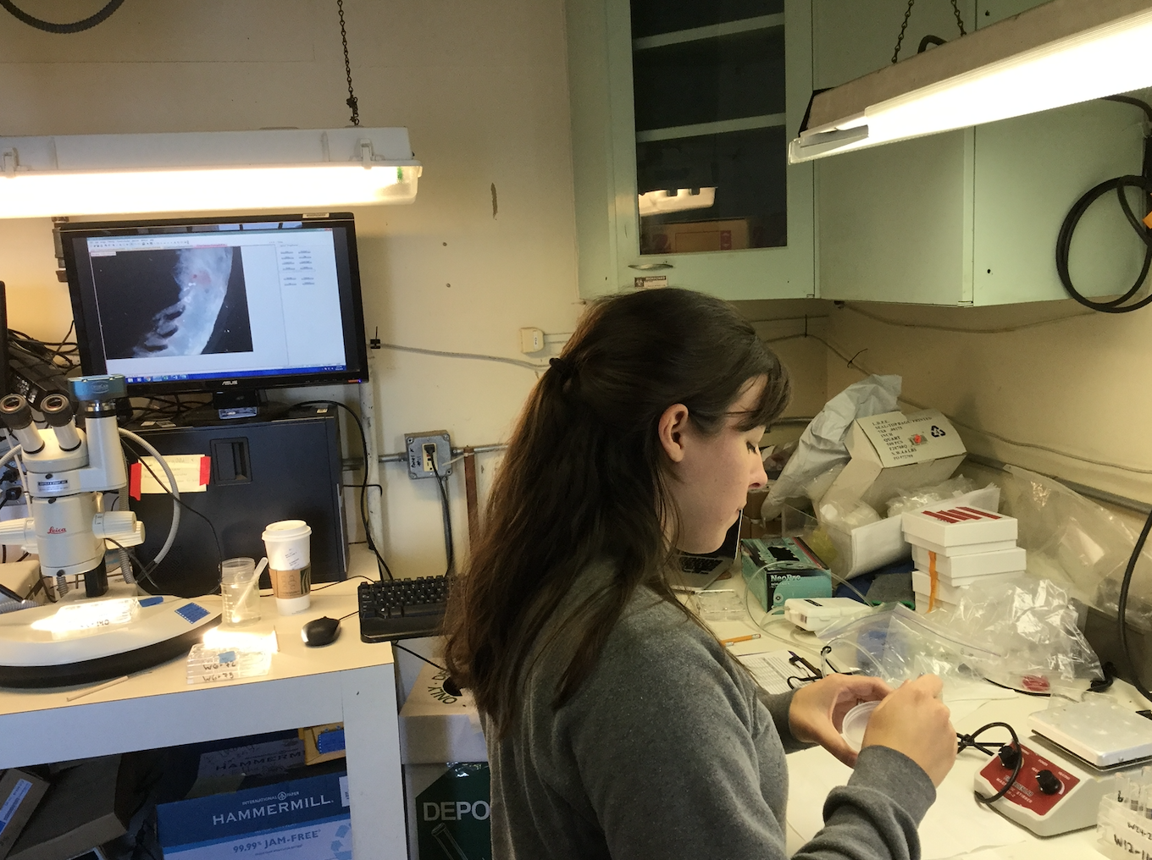

Slide 22
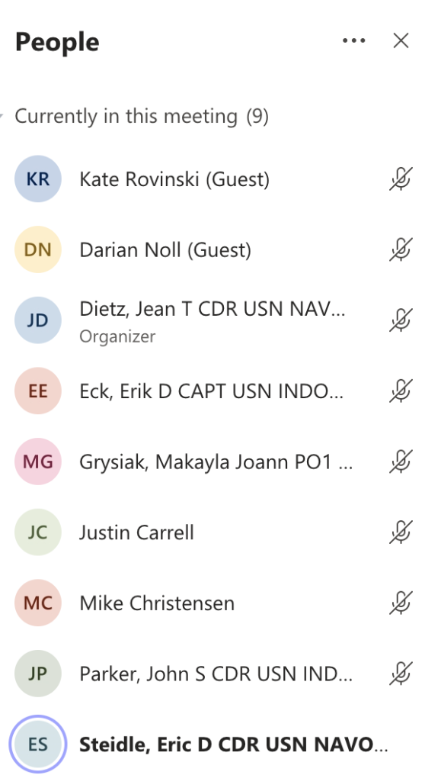
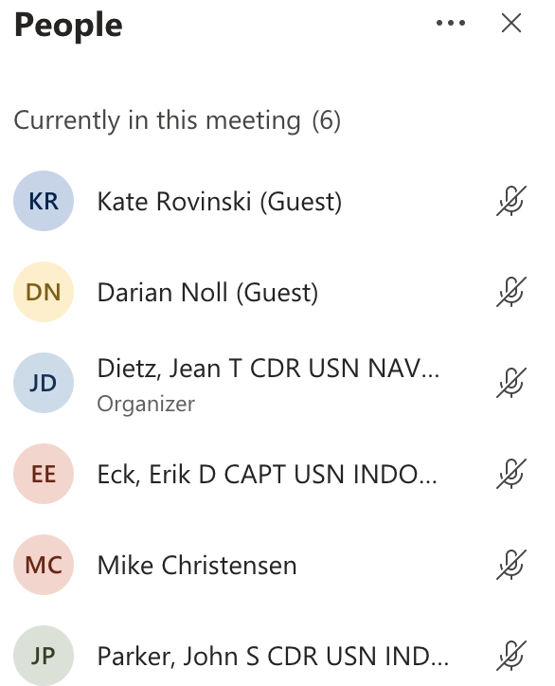
Notes:
Teresa Quinn 425-339-5268, tquinn@snohd.org

